Slide 1
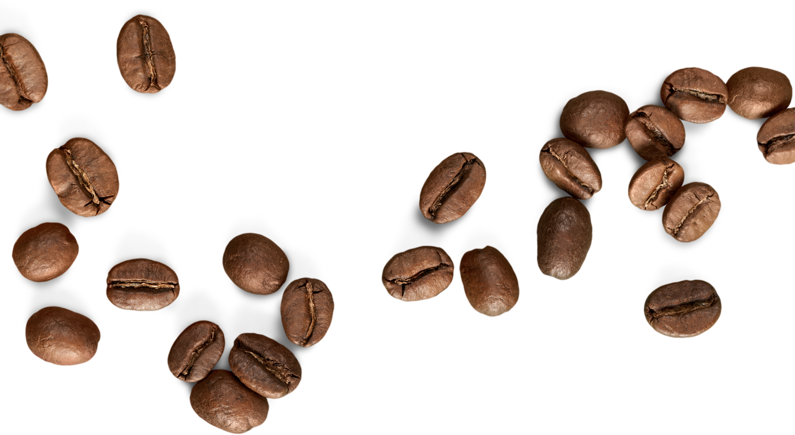



welcome
Bright Coffee Shop
welcome
2
Bright Coffee Shop
This presentation explores the foundations, operations, customer experience, menu design, marketing strategies, and future growth possibilities of bright coffee shops worldwide.
Presented By Johannes Ngwenya

Slide 2
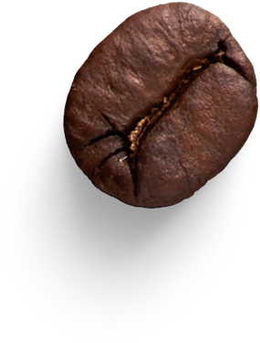
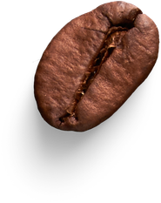
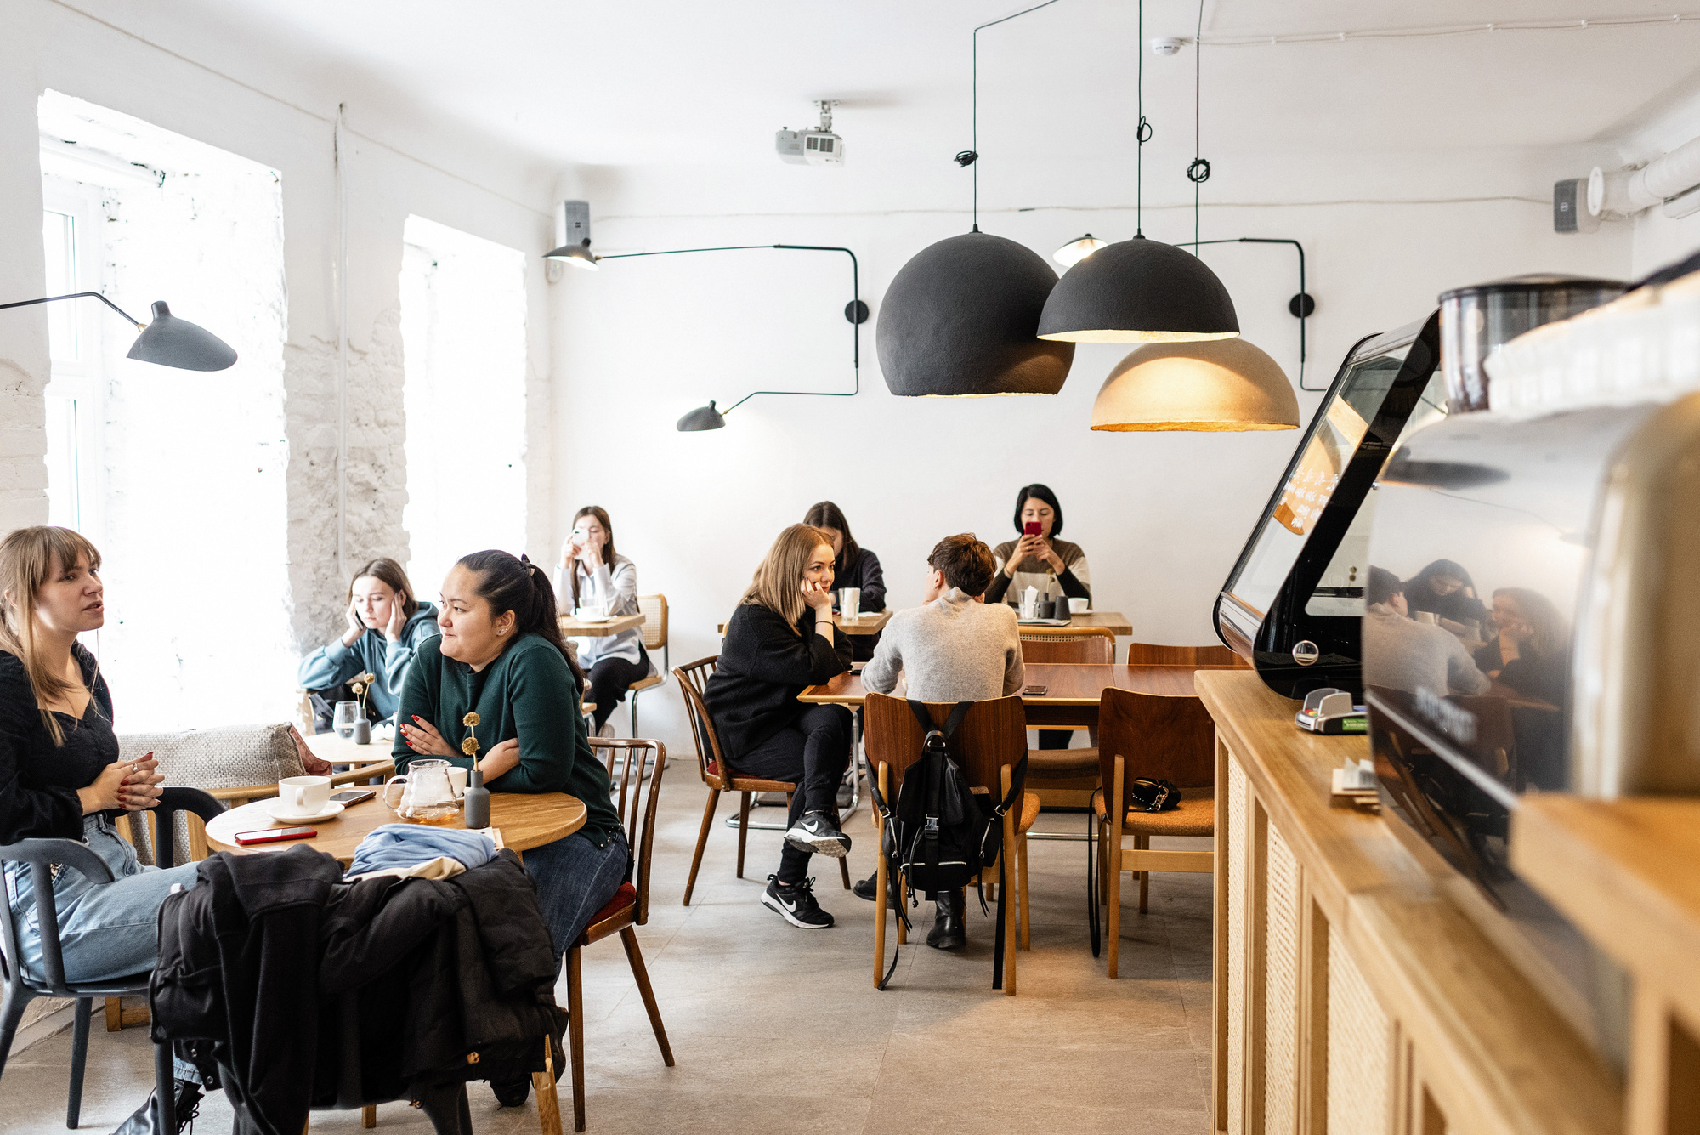
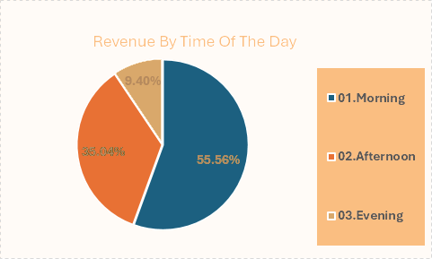
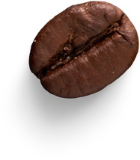
  we make most sales in the mornings between 06h00am - 11h59am
  we make least sales in the Afternoon between 12h00pm - 17h59pm
Bright Coffee Shop
Operating Hours
06h00am - 21h00pm

Slide 3
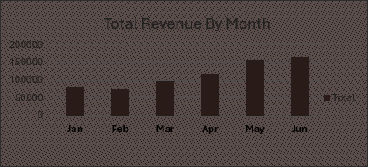
Jan - june
698812,33
Bright Coffee Shop

Slide 4
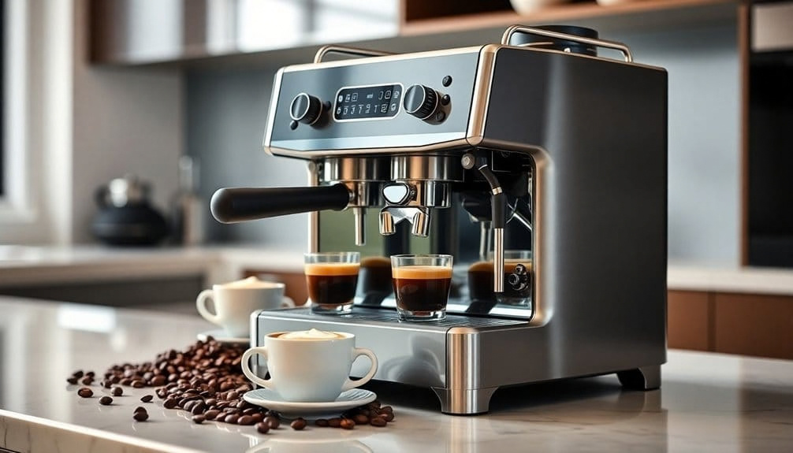

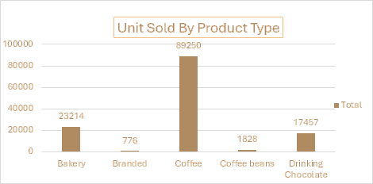
Bright Coffee Shop
Our Best Selling Product

Slide 5
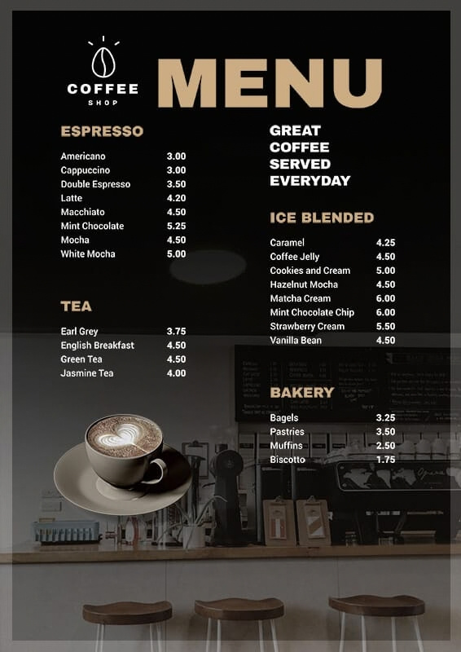
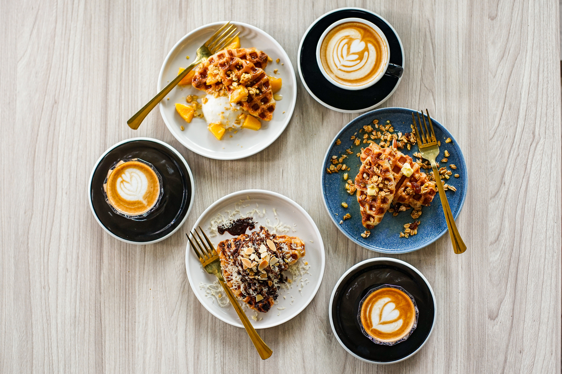
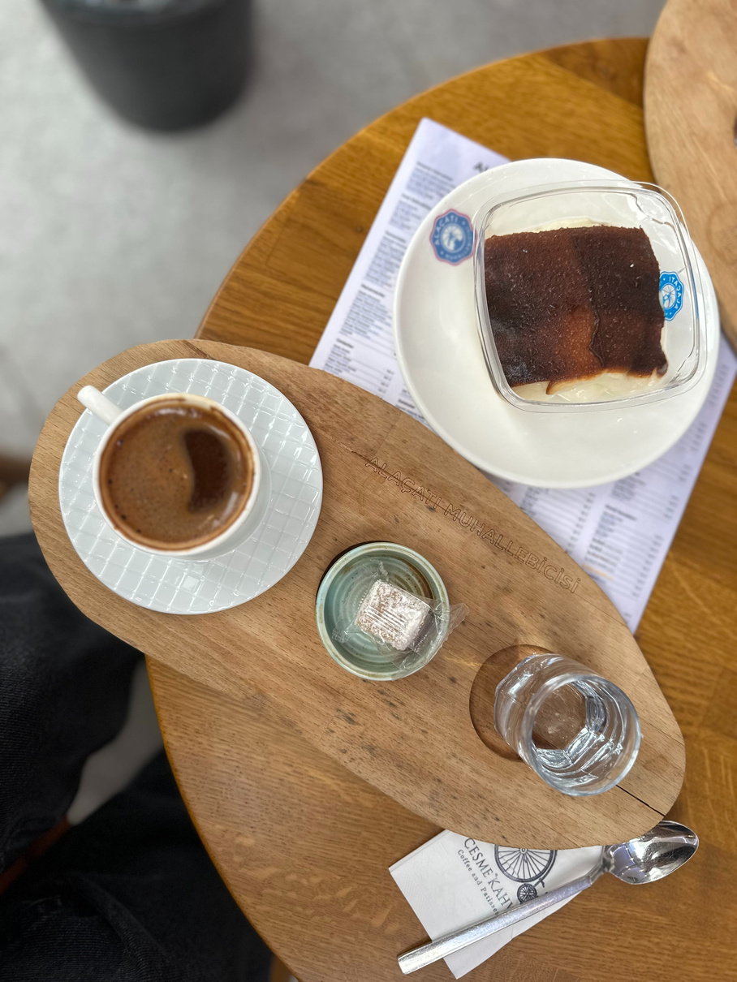
Bright Coffee Shop
New Products Added in our Menu
Develop menu including espresso-based drinks, alternative milk options, seasonal specialties, and light snacks to satisfy customer preferences.

Slide 6
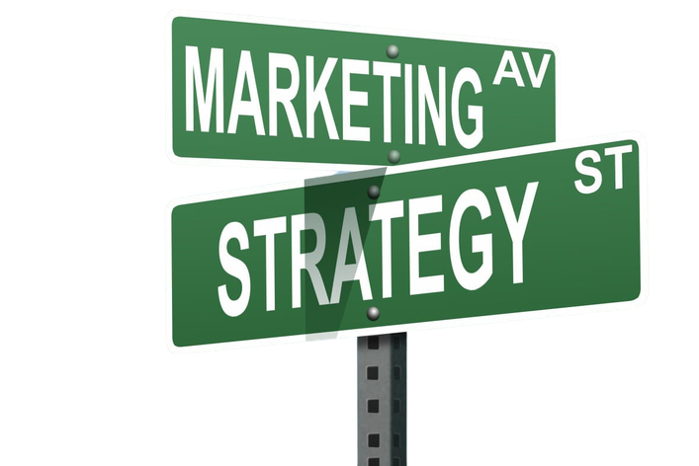
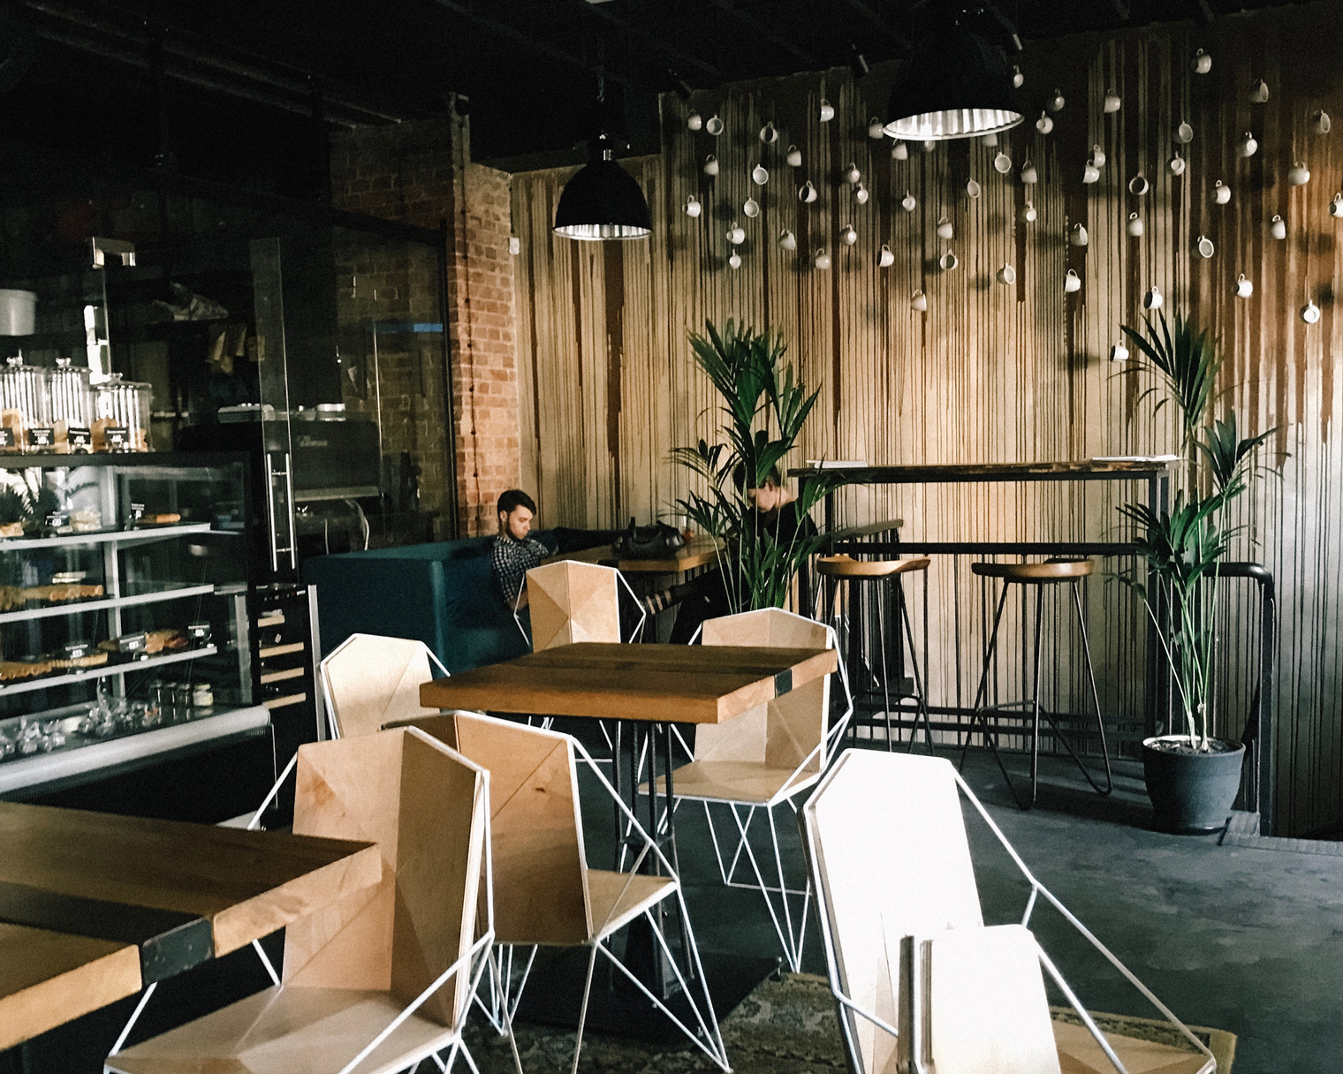
Bright Coffee Shop
Marketing Strategies
01
Local Advertising
Distributing flyers, signage, local press features effectively increases awareness among nearby residents and potential customers.
02
Maintaining active profiles with engaging content, promotions, and customer interactions naturally builds strong community and loyalty.
Referral Programs
03
Offering discounts or free items for referrals incentivizes existing customers to spread word-of-mouth marketing through social media networks.
Community Events
Implement local promotions, social media presence, referral programs, and community partnerships to attract new customers and effectively retain loyal patrons.
04
Hosting workshops, tastings, charity events consistently fosters vibrant community engagement and increases coffee shop overall visibility.

Slide 7
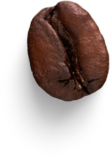

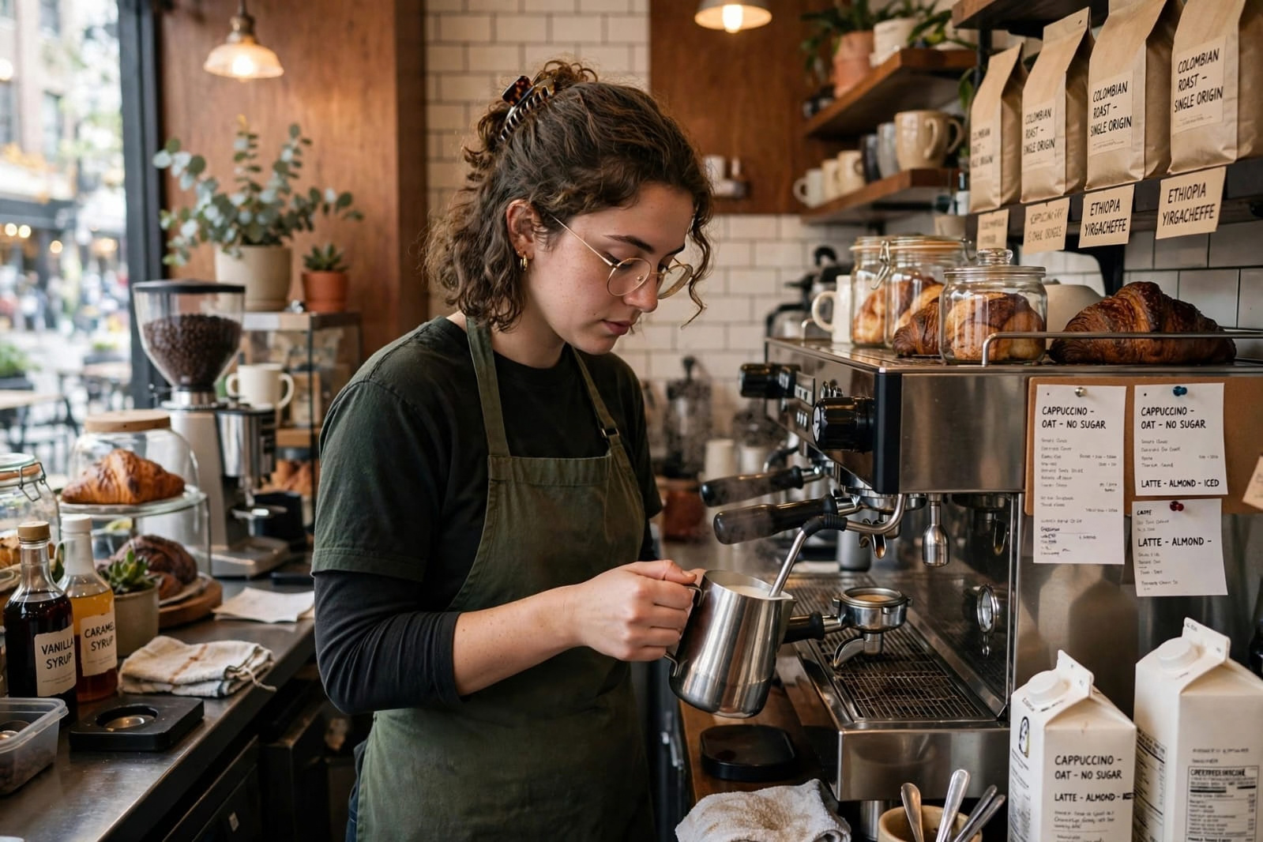
Bright Coffee Shop
TRAINING & Development
Scheduling
Creating balanced staff schedules ensures coverage during peak hours and reduces employee burnout risks.
we ensure that we keep our excellent service level in
all our branches by training and equipping our employees

Slide 8


Bright Coffee Shop
Emerging Coffee Trends
Technology
01
Integrating mobile ordering, contactless payment, and loyalty programs enhances convenience and engagement.
Bright Coffee Shop
Bright Coffee Shop
Sustainability
02
Adopting eco-friendly packaging, ethical sourcing, and waste reduction supports environmental responsibility.
Explore emerging trends such as technology integration, sustainable sourcing, alternative beverage innovations, and shifting consumer preferences for future strategic planning.

Slide 9
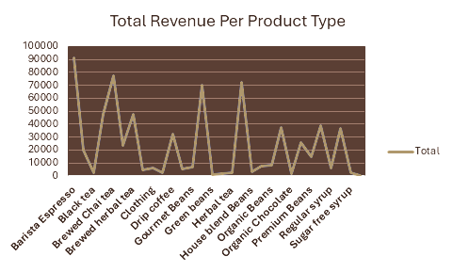

Slide 10




Thank You
call Again
www.bright.coffee.shop
inquiries@brightcoffee.com
+123-456-7890

